Slide 1
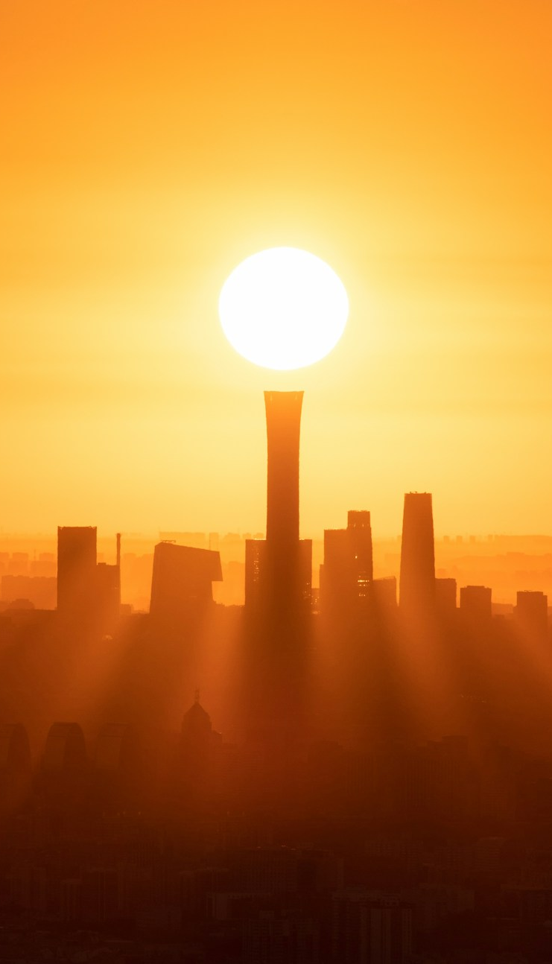
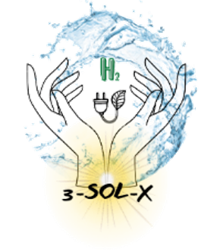


3-SOL-X
CARLOS HERNANDEZ
CEO of Ambar
chernandez@ambarchile.cl
Energy Autonomy and Sustainability
+56 9 9228 9413

Slide 2

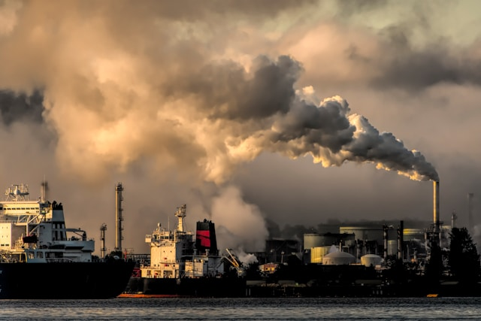

WHY NOW?
Environmental Pollution
>15 USD BILLION
FLOWS TO DEVELOPING COUNTRIES IN
SUPPORT OF CLEAN ENERGY
US: >60 MILLION OF AMERICANS
LIVE IN RURAL AREAS. MANY COMMUNITIES
ARE IN A MORE CRITICAL STATUS.
Energy scarcity & deficiency
20K PACIFIC'S ISLANDS
ENERGY DEPENDENCY > 80% OF DIESEL
> 600 MILLION PEOPLE HAVE NO ELECTRICITY
> 2 BILLION USE HARMFUL FUELS FOR COOKING
Social Impacts:
Barriers to development
Poverty

Slide 3



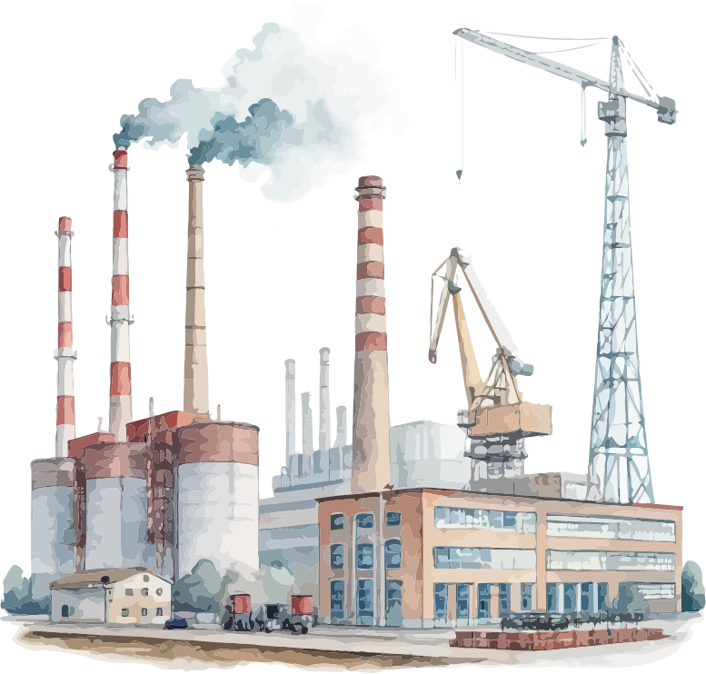
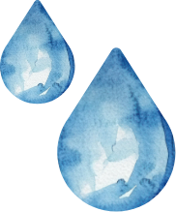
3-SOL-X Solution
Solar Heat
Thermo
Electricity
OR
Green H2
Drinking Water
Industrial Heat

Slide 4

HOW IT WORKS

Slide 5

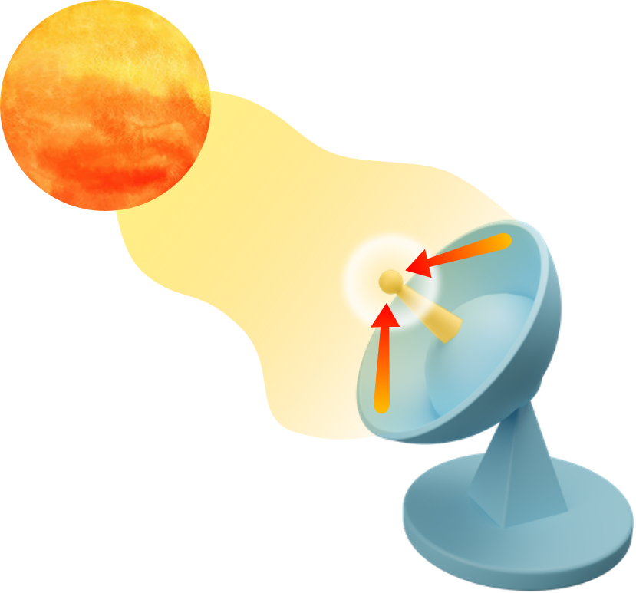

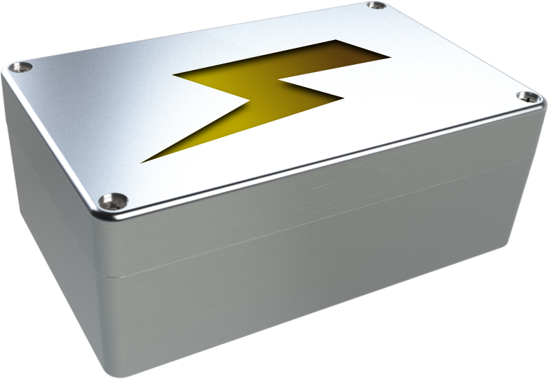

3-SOL-X SOLAR
General
Purpose
Ambar's Electricity
Generation
Thermo
Electricity
Drinking Water
Solar Heat
Cooking appliances
with 100% H2
Green H2
Heat Storage for 24/7 Electricity Generation
Option:
Battery Storage

Slide 6
3-SOL-X MARKET & CUSTOMERS
Rural areas
Emergency camps, military or refugee camps. Rural agro-industrial or indigenous communities.
Countries with green policies
United States, Chile, Pacific Islands and more.
Remote areas
With high dependence on oil and gas (over 80%) and with high electricity costs (over USD$ 0.2/kWh).
Power Companies
Power Companies transitioning to green energies.
Governments
Governments funding green energy projects.
Pacific Islands Electricity Market
7,928,753 inhabitants without access to electricity.
Required Annual Electricity Generation of 17,197,964 MWh.

Slide 7
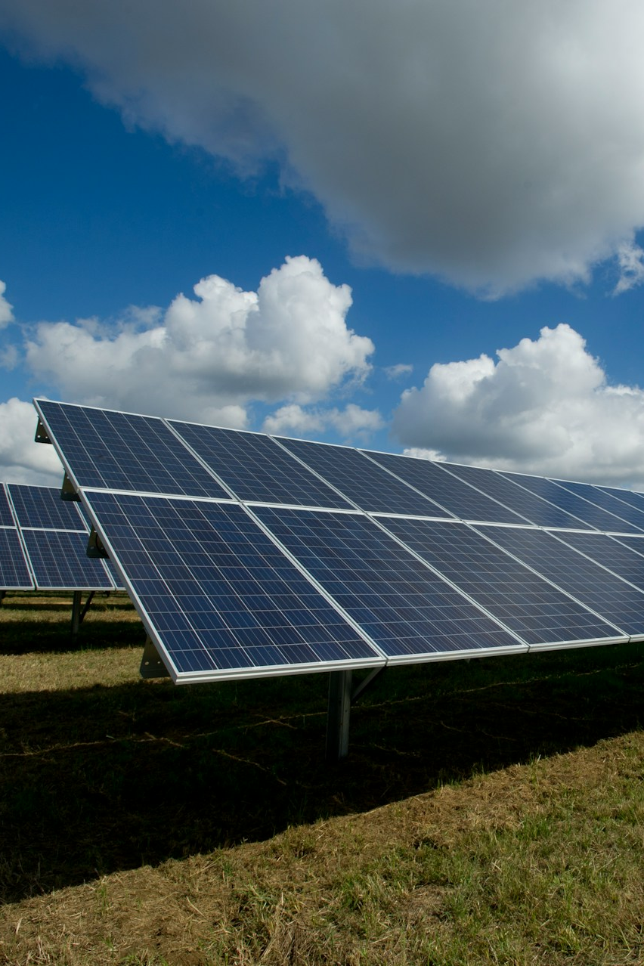
3-SOL-X COMPETITION
PHOTOVOLTAICS (PV)
Short useful life (<15 years).
High LCOE. Hardware with high carbon footprint.
24/7 Energy generation requires batteries. Increases LCOE & Carbon footprint.
Not modular solutions for integrated generation of electricity & H2.
WIND POWER
Demands extensive spatial resources.
High LCOE.
HYDROELECTRIC AND THERMAL POWER PLANTS
Requires High Voltage transmission lines.
High environmental impact.and waste management issues.

Slide 8
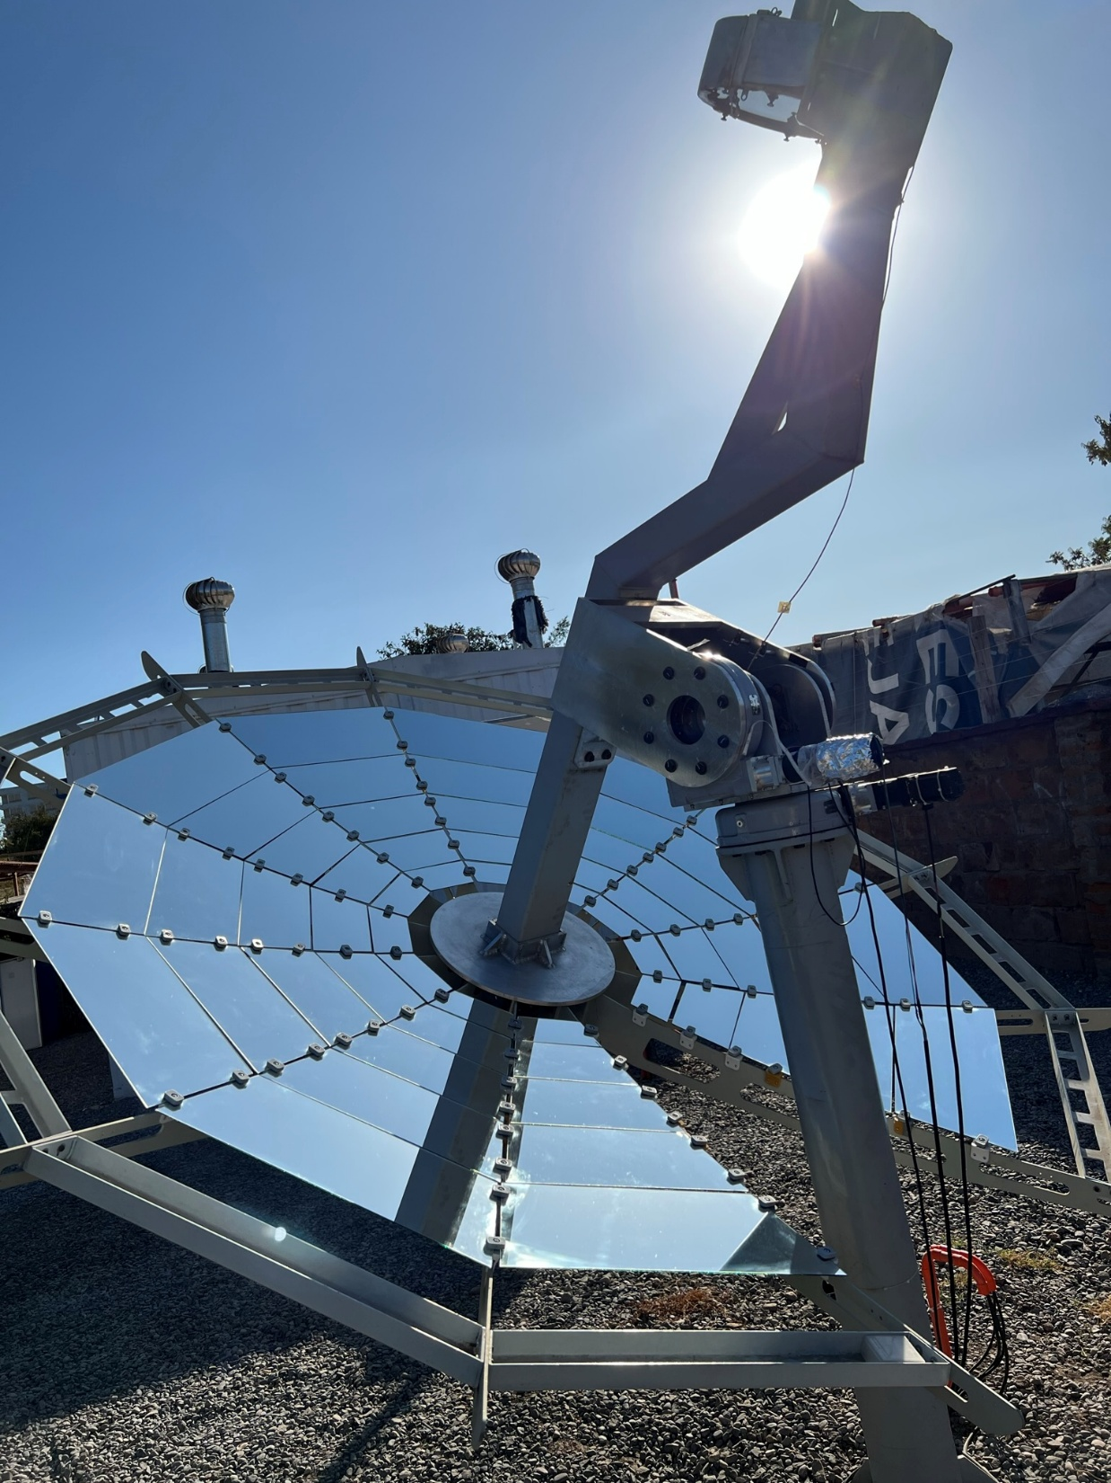
3-SOL-X Unique Value Proposition
Captures heat and generates electricity, green H2 and drinking water.
Modular and Autonomous energy generation.
US 10.539.045 B2 patent granted in 2020 in United States.
Heat storage for 24/7 energy generation.
Carbon footprint 13 times smaller than PVs.
20% cheaper and 30% smaller than PVs.

Slide 9
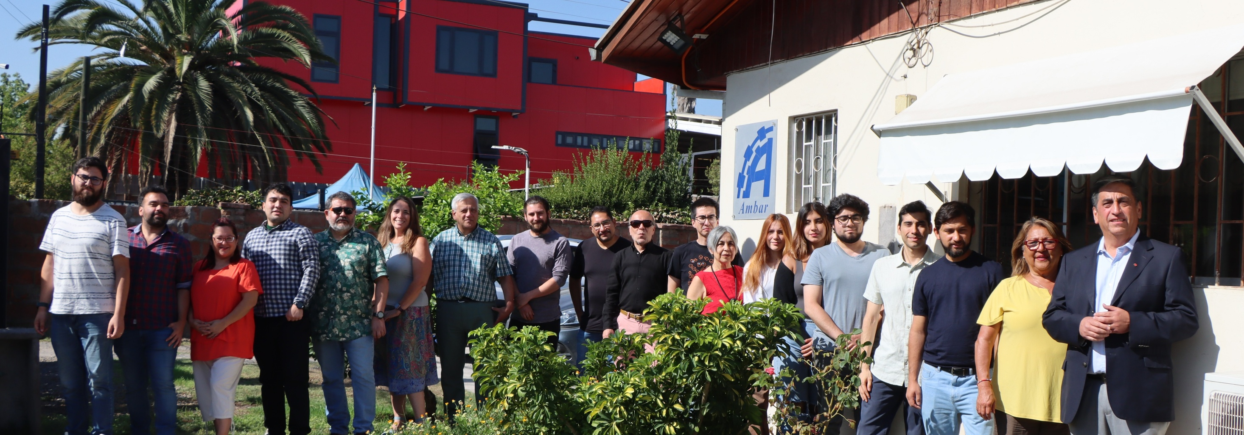


It’s your chance to be part of the future of Energy! Join us!
CARLOS HERNANDEZ
CEO of Ambar
www.ambarchile.cl
ambar@ambarchile.cl
+56 2 2428 9300
chernandez@ambarchile.cl
+56 9 9228 9413
IGOR BERMEJO
R&D Control Leader
ibermejo@ambarchile.cl
+56 9 6596 6014

